Slide 1
Use Case Diagrams
Iteration 3 and Iteration 4

Slide 2
Use Case Diagram Iteration 3

Slide 3
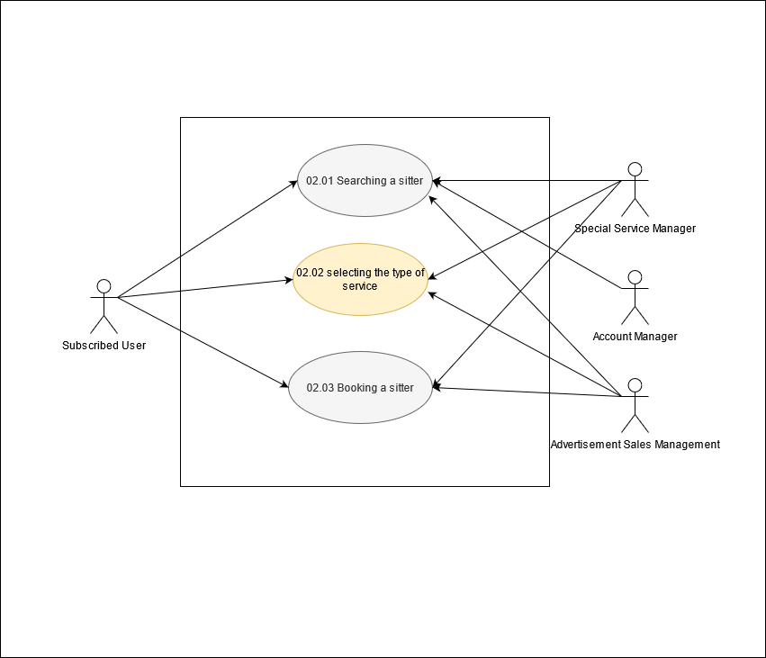
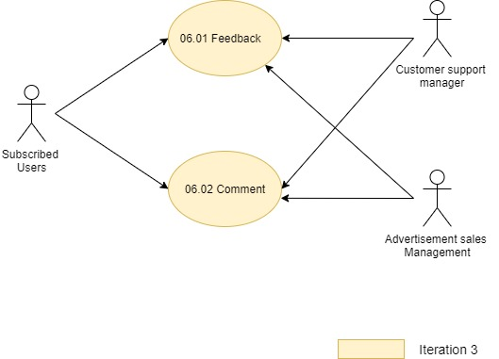
Module 02 : Booking Module

Slide 4
Module 06 : Review

Slide 5
Use Case Diagram Iteration 4

Slide 6
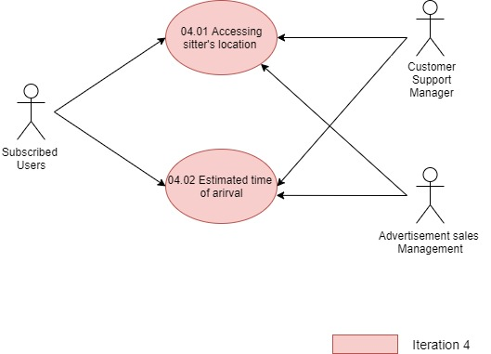
Module 04 : Sitter Monitoring

